Slide 1
Vet System Tutorial

Slide 2
Table of Contents
1 INTRODUCING THE VET SYSTEM ....................................................................................... 3
1.1 WHO SHOULD USE THIS APPLICATION ......................................................................................... 3
1.2 WHO SHOULD USE THIS GUIDE................................................................................................... 4
2 KEY FEATURES............................................................................................................................. 5
2.1 FEATURES FOR ADMINISTRATIVE USERS ...................................................................................... 5
2.2 FEATURES FOR VET USERS........................................................................................... 6
3 ADMINISTRATIVE USERS – A GUIDED TOUR ............................................................................ 7
3.1 LOGIN ........................................................................................................................................ 7
3.2 CREATE USERS ............................................................................................................... 10
3.3 DELETE USERS ................................................................................................................ 16
3.4 UPDATE PASSWORDS .................................................................................................................. 18
3.7 LOG OUT

Slide 3
Table of Contents Con.
4 VETERINIRIAN USERS – A GUIDED TOUR ............................................................................ 7
4.1 LOGIN ........................................................................................................................................ 7
4.2 PET MEDICAL RECORD SEARCH............................................................................................................... 10
4.3 EMPLOYEE FEATURES................................................................................................................ 16
4.4 VIEW OWNER INFO.................................................................................................................. 18
4.7 LOG OUT
5 EMPLOYEE USERS – A GUIDED TOUR ............................................................................ 7
5.1 VIEW PET INFO ........................................................................................................................................ 7
5.2 EDIT PET INFO............................................................................................................... 10
5.3 ADD NEW PET................................................................................................................ 16
5.4 DELETE PET .................................................................................................................. 18
5.7 UPDATE OWNER INFO ……………………………………………………………………………………………….19

Slide 4
Table of Contents Con.
3 OWNER USERS – A GUIDED TOUR ............................................................................ 7
3.1 LOGIN ........................................................................................................................................ 7
3.2 VIEW RECORD............................................................................................................... 10
3.3 VIEW APPOINTMENTS................................................................................................................ 16
3.4 UPDATE PASSWORDS .................................................................................................................. 18
3.7 LOG OUT

Slide 5
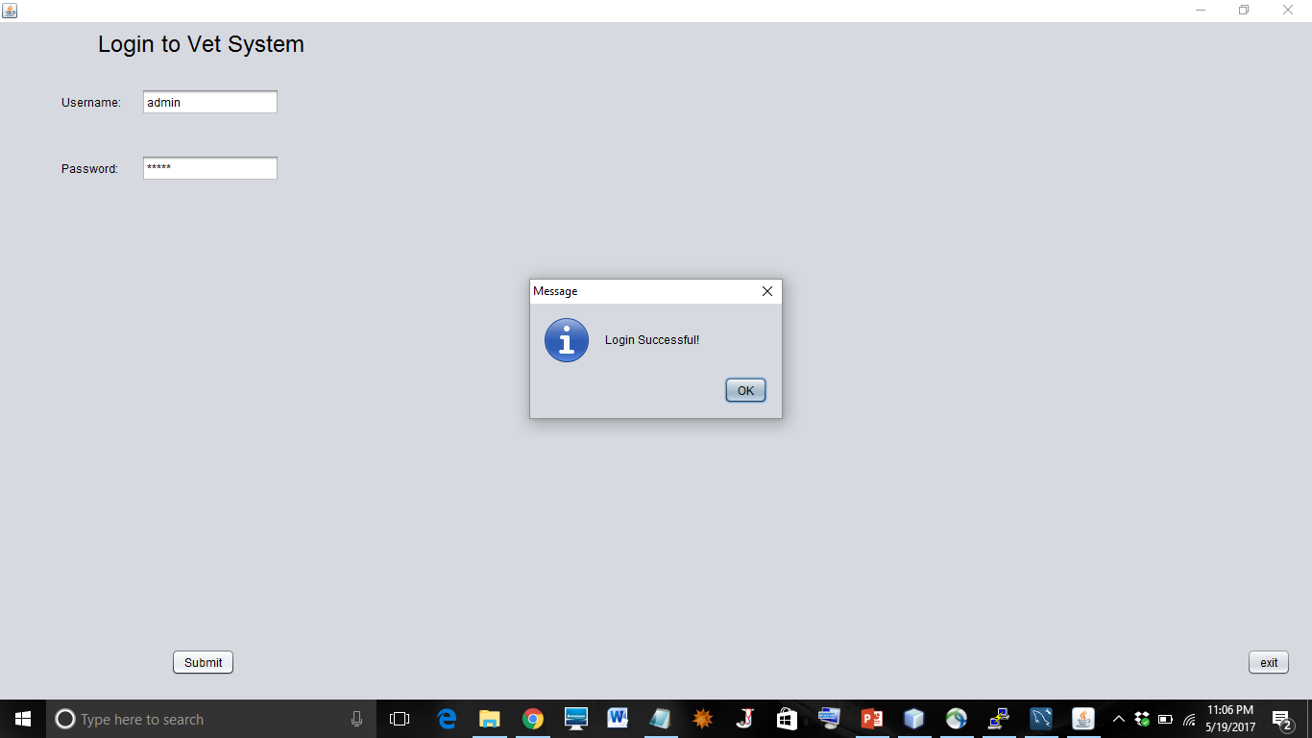

Slide 6
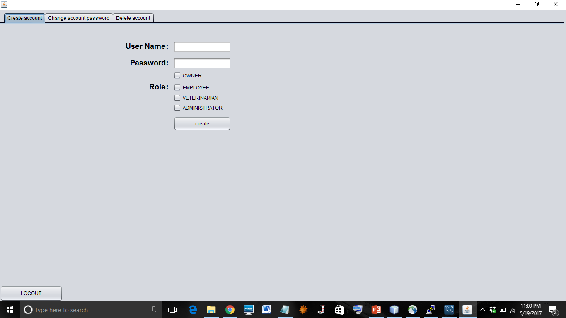

Slide 7
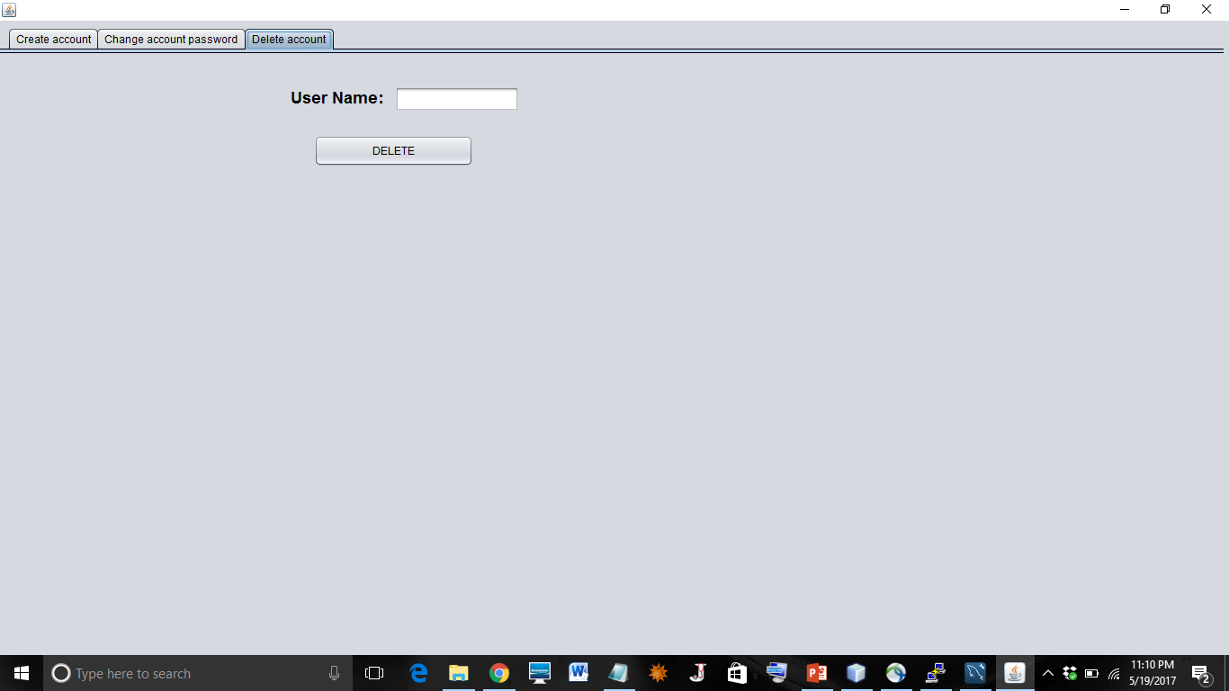

Slide 8
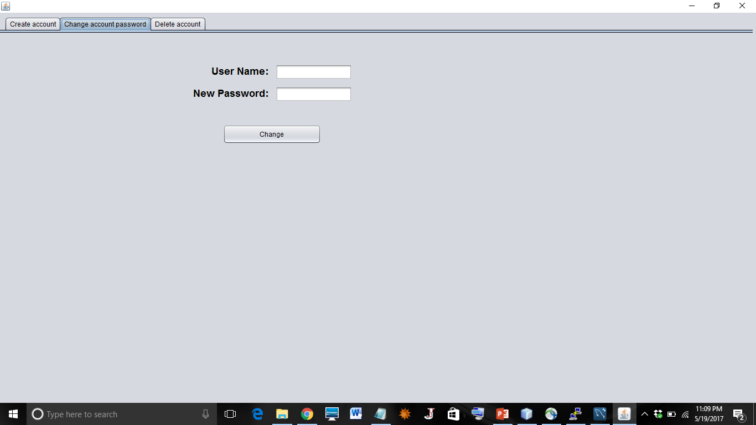

Slide 9


Slide 10
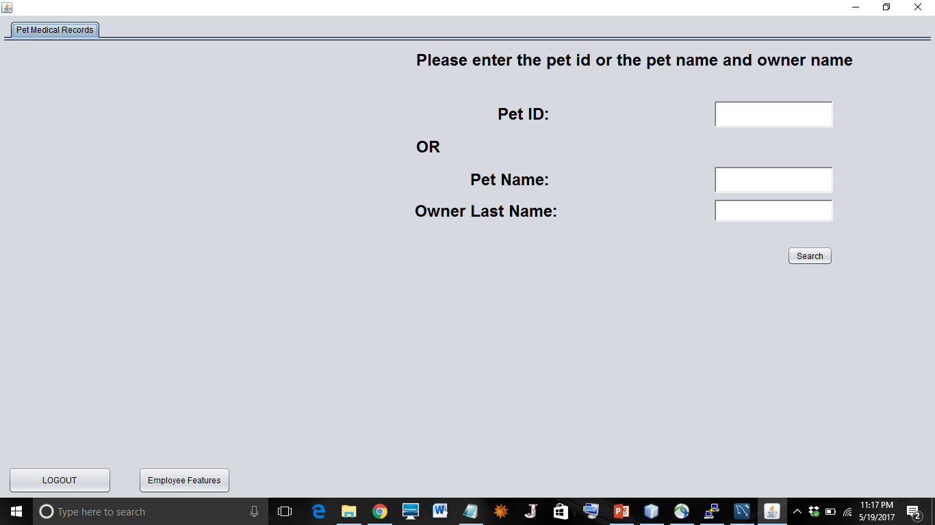

Slide 11
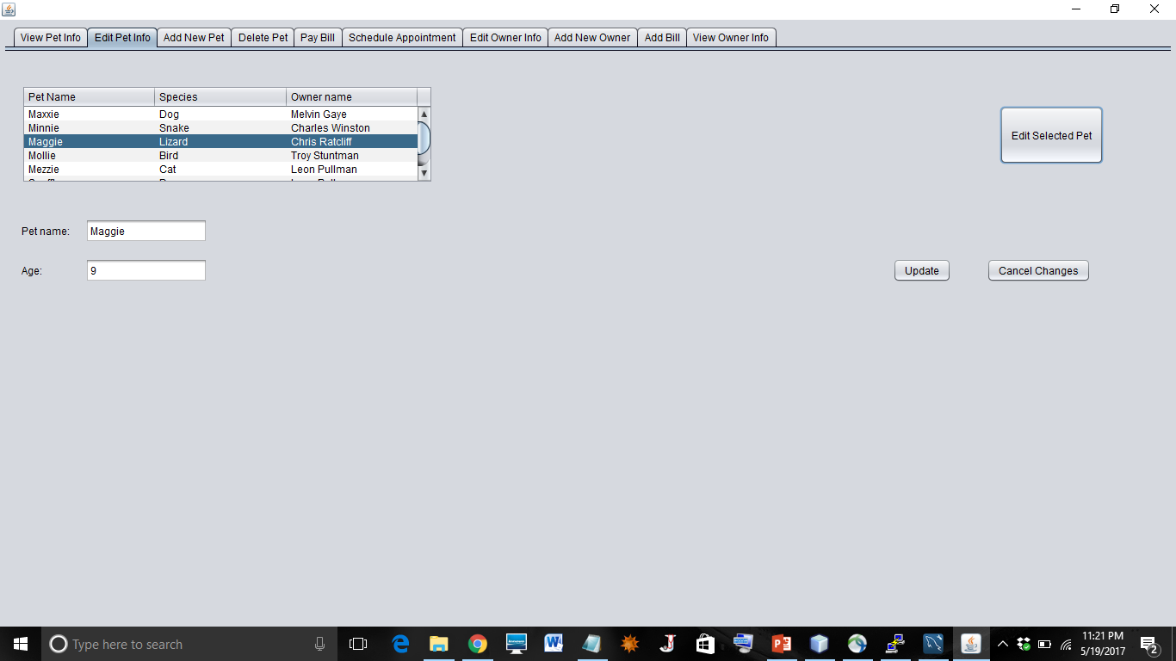

Slide 12
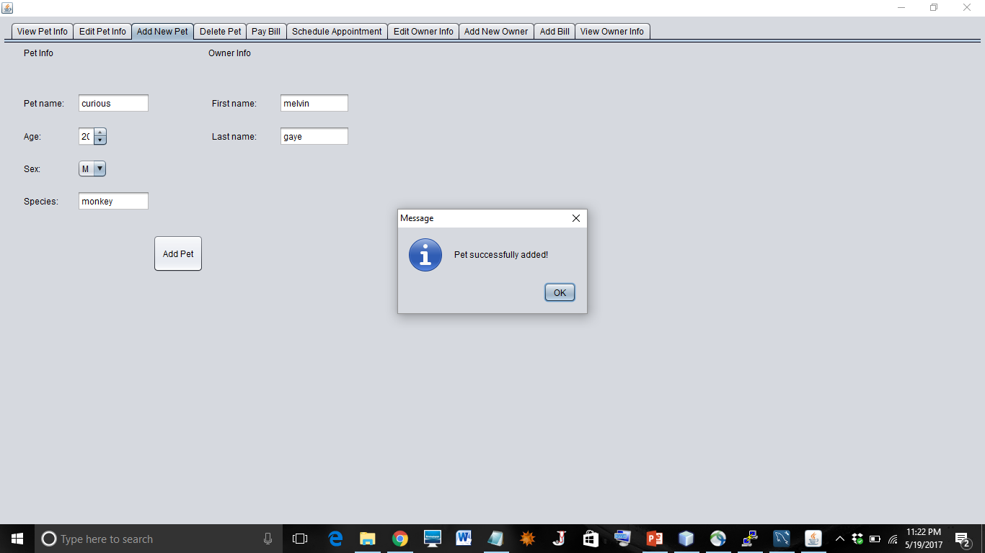

Slide 13
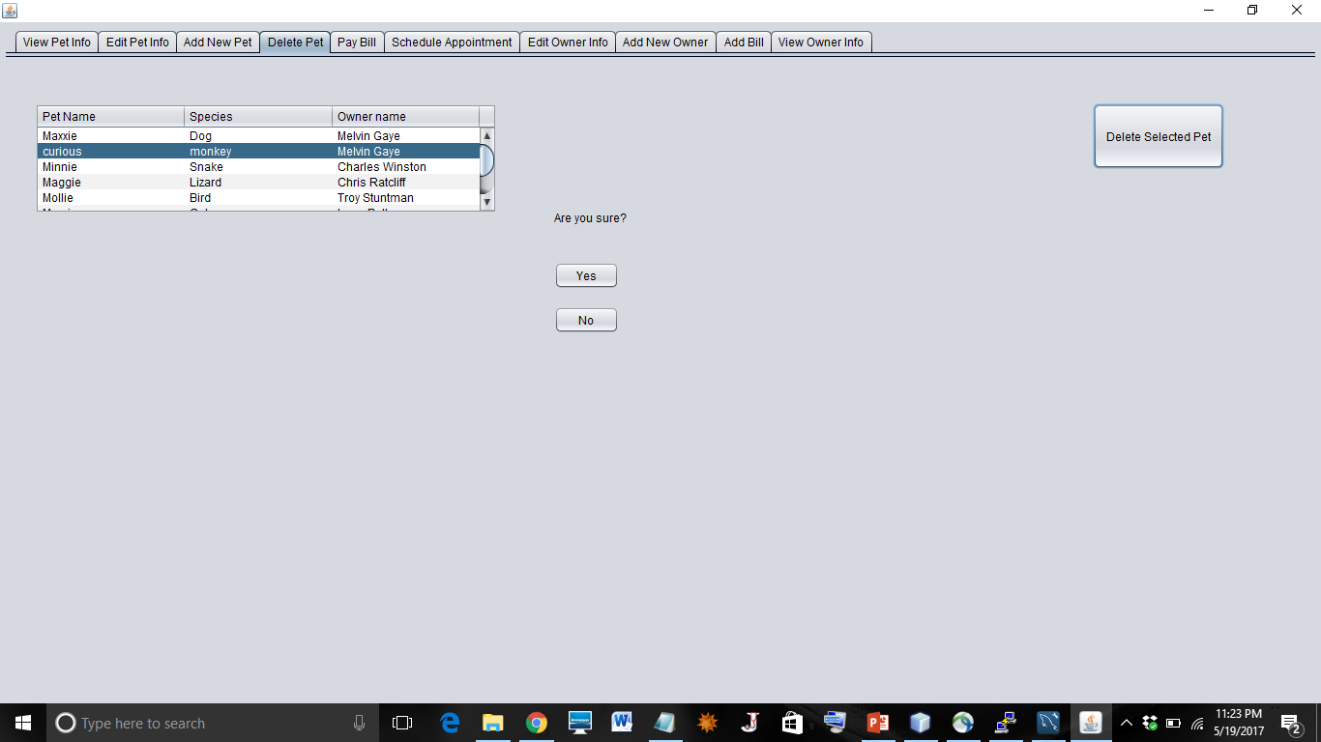

Slide 14
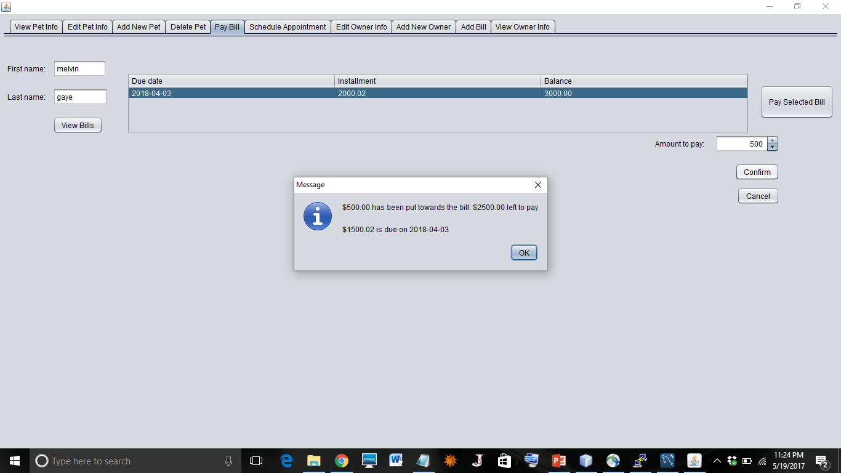

Slide 15
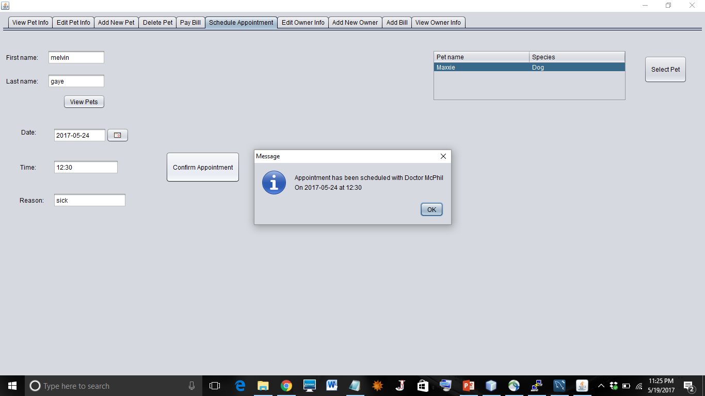

Slide 16
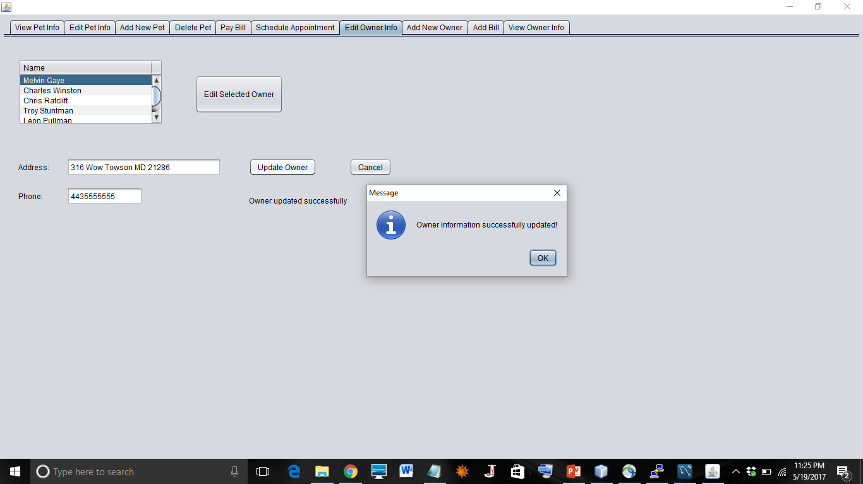

Slide 17
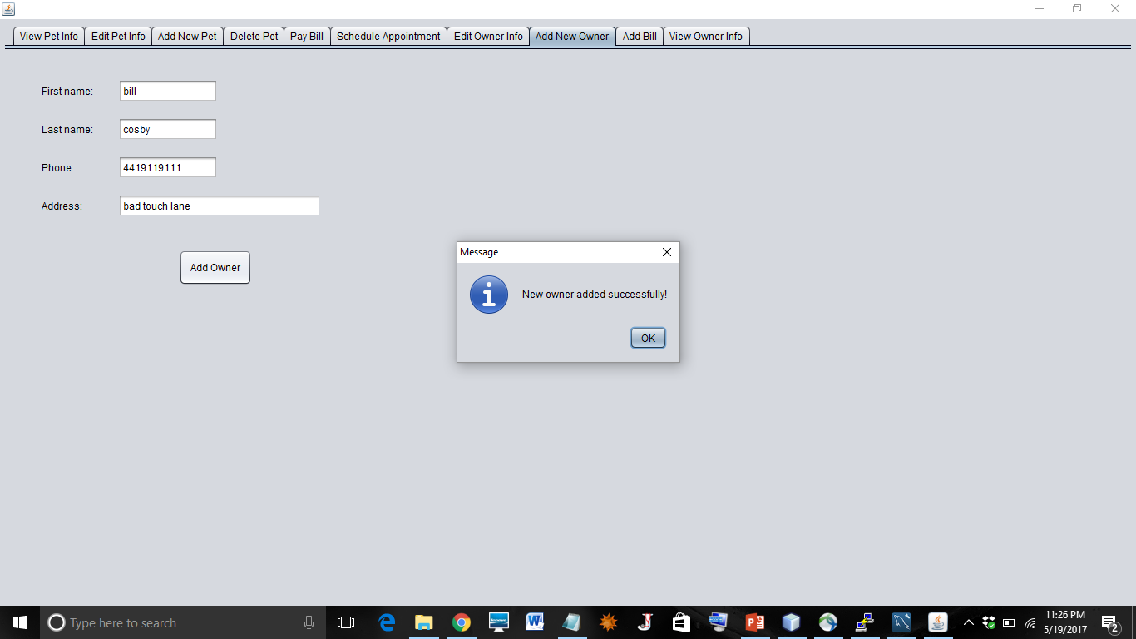

Slide 18
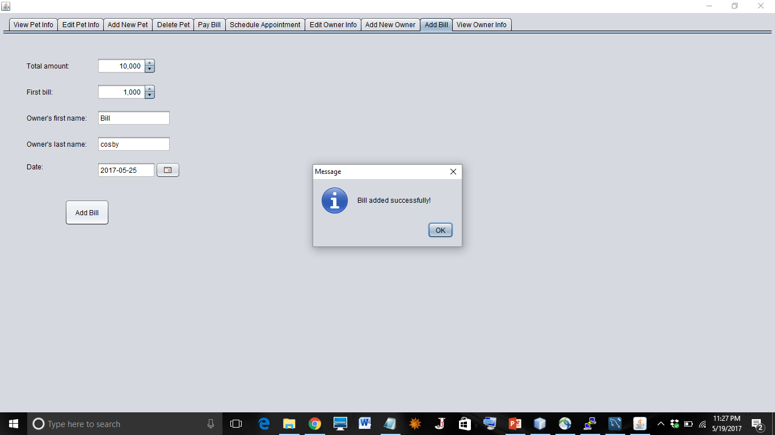

Slide 19
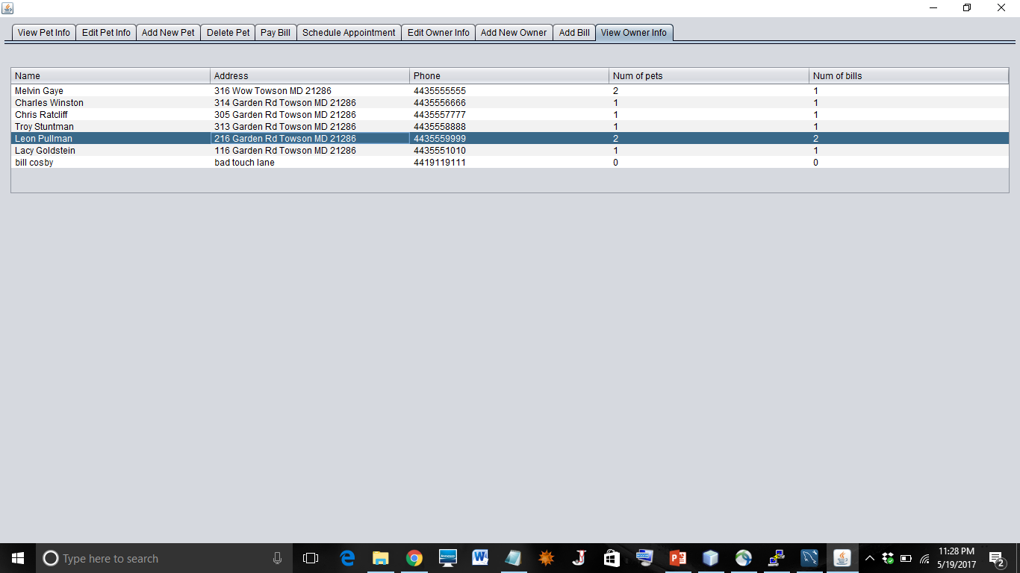

Slide 20
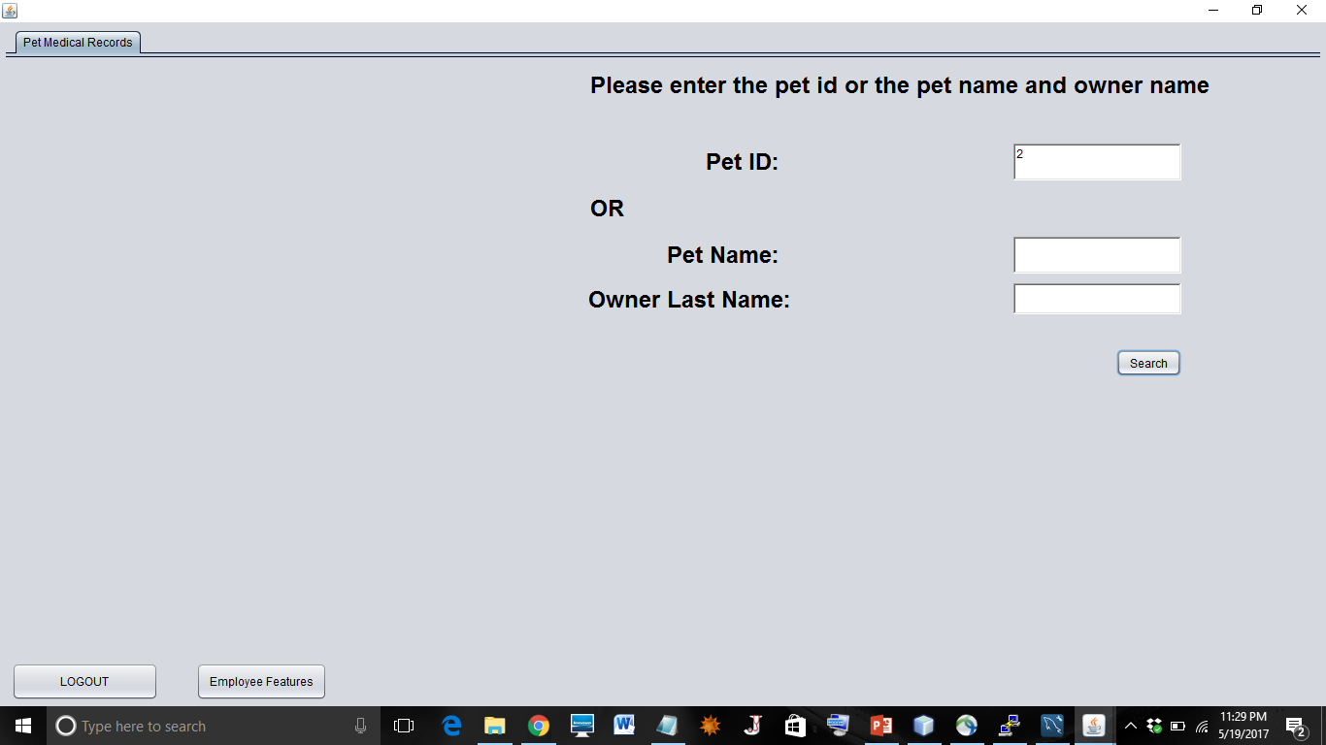

Slide 21
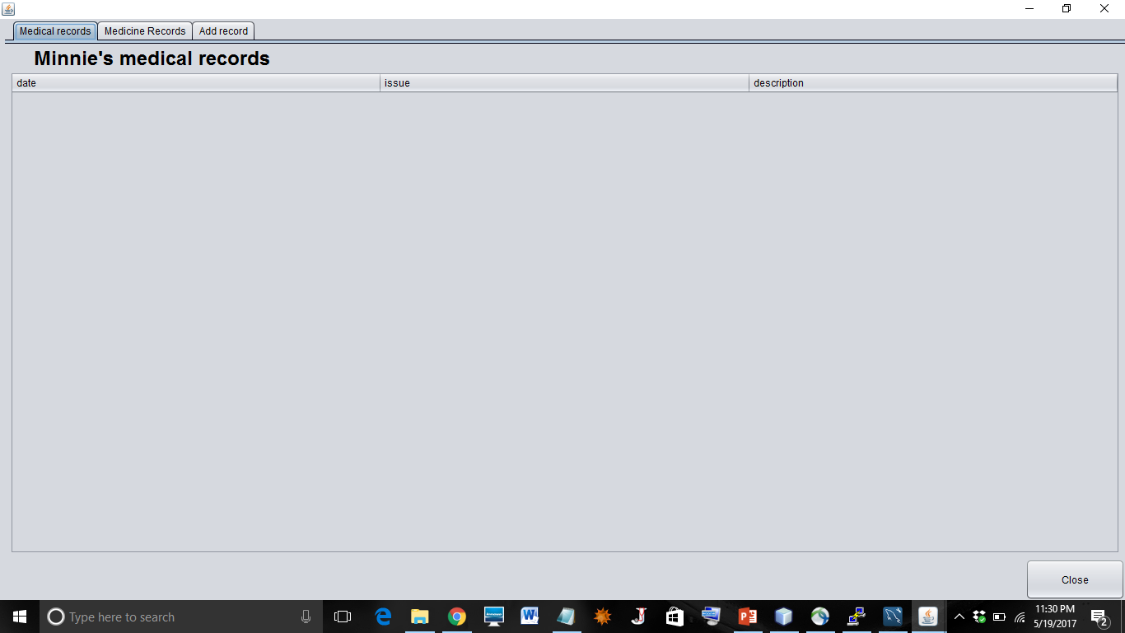

Slide 22
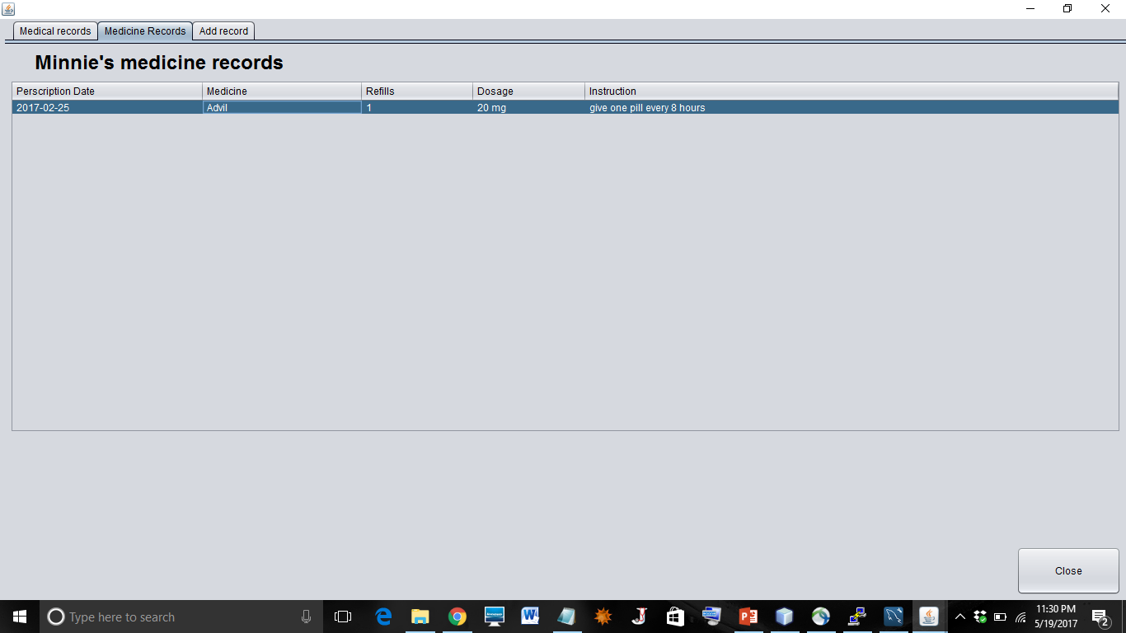

Slide 23
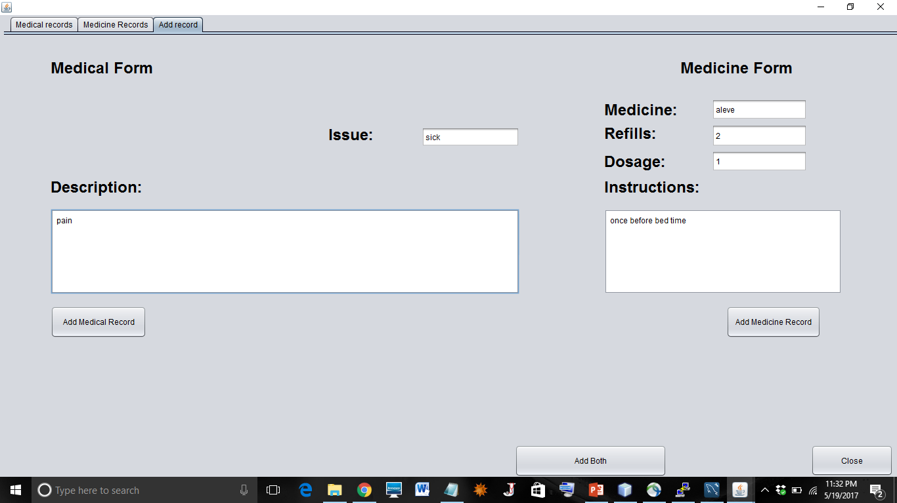

Slide 24
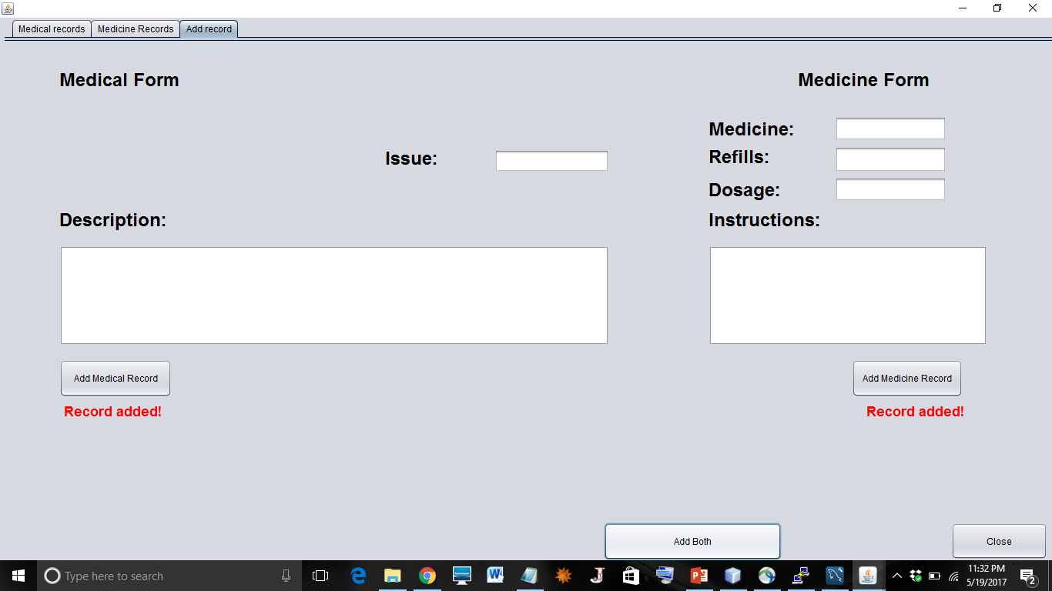

Slide 25


Slide 27
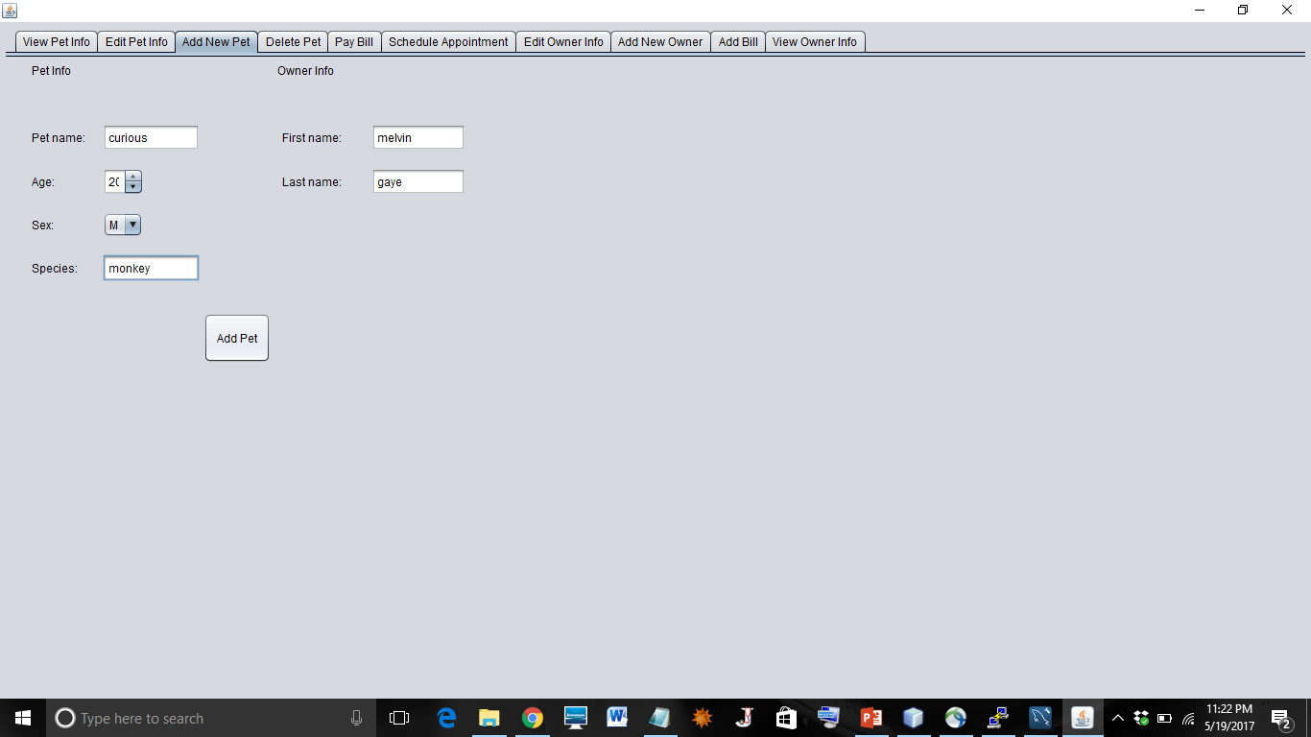

Slide 36


Slide 37
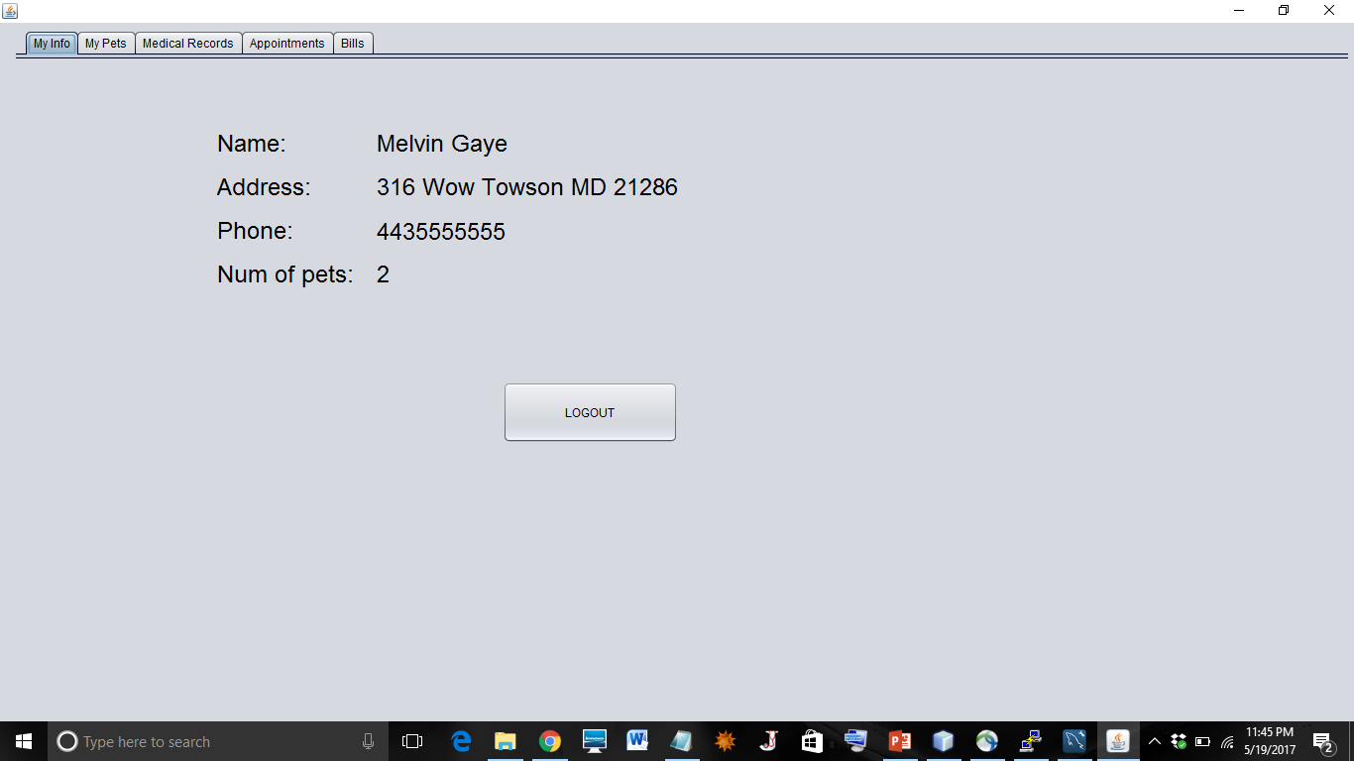

Slide 38
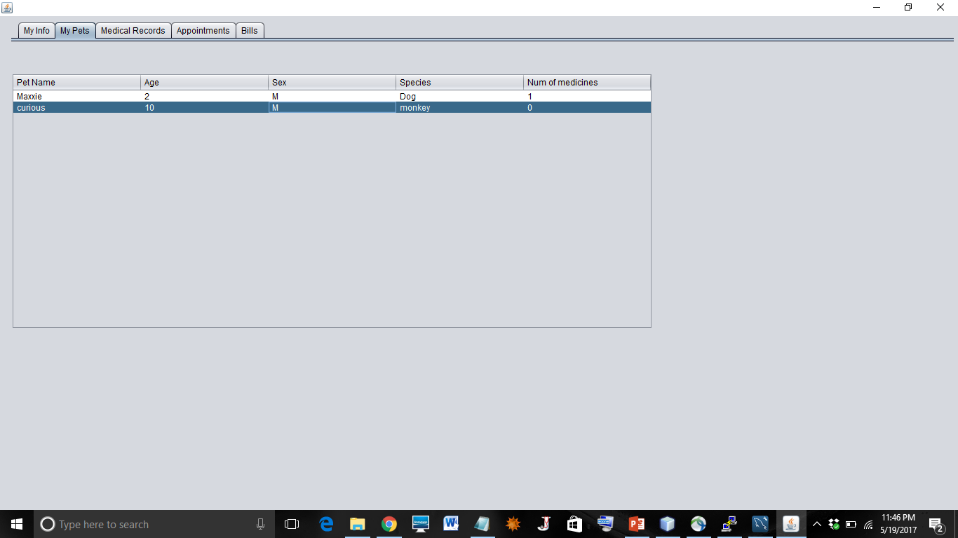

Slide 39
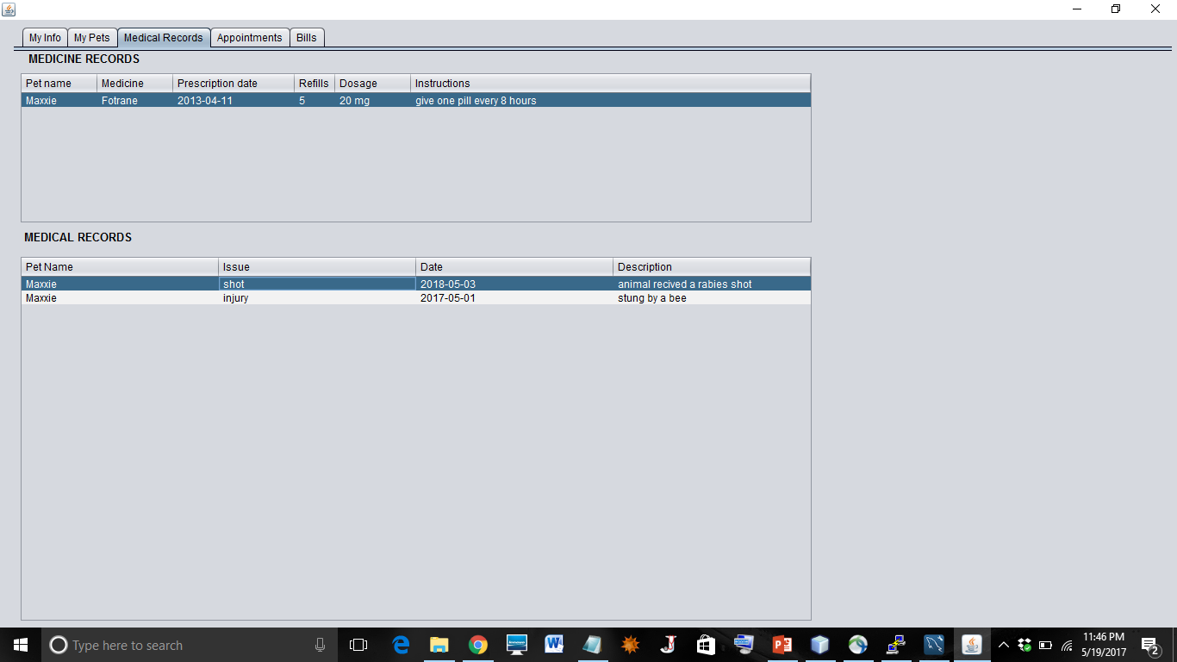

Slide 40
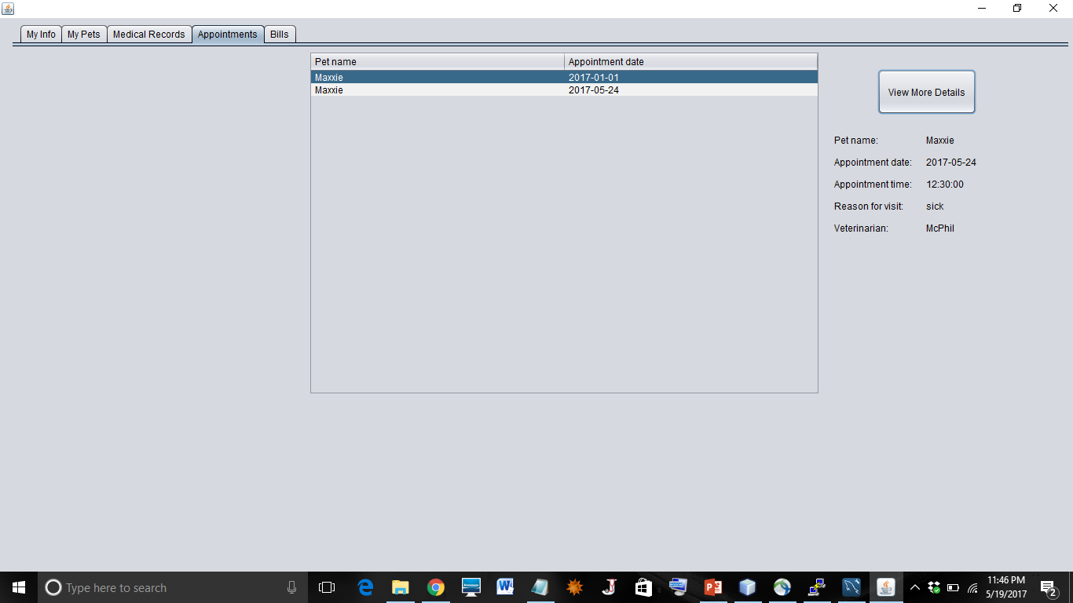

Slide 41
